Slide 1
Ch-2 Lattices & Boolean Algebra
2.1. Partially Ordered Sets
2.2. Extremal Elements of Partially Ordered Sets
2.3. Lattices
2.4. Finite Boolean Algebras
2.5. Functions on Boolean Algebras

Slide 2
Partially Ordered Sets
Partial Order
A relation R on a set A is called a partial order if R is reflexive, anti-symmetric and transitive. The set A together with the partial order R is called a partially ordered set, or simply a poset, denoted by (A, R)
For instance,
Let A be a collection of subsets of a set S. The relation ⊆
of set inclusion is a partial order on A, so (A, ⊆) is a poset.
Let Z⁺ be the set of positive integers. The usual relation ≤ is a partial order on Z⁺, as is “≥”
Let R be a partial order on a set A, and let R⁻¹ be the inverse relation of R. Then R⁻¹ is also a partial order.

Slide 3
Example
Let A={1,2,3,4,12}. consider the partial order of divisibility on A. Draw the corresponding Hasse diagram.
12
12
4
4
3
3
2
2
1
1

Slide 4
Example
Let S={a,b,c} and A=P(S). Draw the Hasse diagram of the poset A with the partial order ‘⊆’
{a,b,c}
{b,c}
{a,b}
{a,c}
{c}
{b}
{a}
ф

Slide 5
Comparable
If (A, ≤) is a poset, elements a and b of A are comparable if
a ≤ b or b ≤ a
In some poset, e.g. the relation of divisibility (a R b iff a | b), some pairs of elements are not comparable
2 | 7 and 7 | 2
Note: if every pair of elements in a poset A is comparable, we say that A is linear ordered set, and the partial order is called a linear order. We also say that A is a chain or totally ordered set.

Slide 6
Extremal Elements of Partially Ordered Sets
Consider a poset (A, ≤ )
Maximal Element
An element a in A is called a maximal element of A if there is no element c in A such that a ≤ c.
Minimal Element
An element b in A is called a minimal element of A if there is no element c in A such that c ≤ b.
An element a in A is a maximal (minimal) element of (A, ≥ ) if and only if a is a minimal (maximal) element of (A, ≤ )

Slide 7
Extremal Elements of Partially Ordered Sets
Example: Find the maximal and minimal elements in the following Hasse diagram
a3
Maximal elements
a1
a2
Note: a1, a2, a3 are incomparable b1, b2, b3 are incomparable
b1
b2
b3
Minimal element

Slide 8
Extremal Elements of Partially Ordered Sets
Example
Let A be the poset of nonnegative real number with the usual partial order ≤ . Then 0 is a minimal element of A. There are no maximal elements of A
Example
The poset Z with the usual partial order ≤ has no maximal elements and has no minimal elements

Slide 9
Greatest element
An element a in A is called a greatest element of A if
x ≤ a for all x in A.
Least element
An element a in A is called a least element of A if
a ≤ x for all x in A.
Note: an element a of (A, ≤ ) is a greatest (or least) element if and only if it is a least (or greatest) element of (A, ≥ )

Slide 10
Extremal Elements of Partially Ordered Sets
Unit element
The greatest element of a poset, if it exists, is denoted by 1 and is often called the unit element.
Zero element
The least element of a poset, if it exists, is denoted by 0 and is often called the zero element.

Slide 11
Theorem 1
If (A, ≤ ) be a poset, then
If greatest element exists, then it is unique.
If least element exists, then it is unique. Proof:
Assume that there are two greatest elements of poset (A, ≤ ), say a and b.
Therefore, x ≤ a and x ≤ b, ∀ x ∈ A.
∴a ≤ b (b is greatest element) and b ≤ a (a is greatest element)
∴by antisymmetric property, a = b. Similarly, for least element.

Slide 12

Theorem 2
Let (L,∨, ∧) be a lattice.
commutative law for join and meet: For a, b ∈ L, a ∨ b = b ∨ a; a ∧ b = b ∧ a
Associative law for join and meet: For a, b, c ∈ L, (a ∨ b) ∨ c = a ∨ (b ∨ c ); (a ∧ b) ∧ c = a ∧ (b ∧ c )
Absorption law for join and meet: For a, b ∈ L, a ∨ (a ∧ b) = a ; a ∧ (a ∨ b) = a
Proof:
Let a, b ∈ L,
a ∨ b = l.u.b.{a,b} = l.u.b.{b,a} = b ∨ a a ∧ b = g.l.b.{a,b} = g.l.b.{b,a} = b ∧ a

Slide 13
Proof of (2): Associative law: For a, b, c ∈ L,
Let a, b ∈ L,
b ≤ (a ∨ b) ≤ (a ∨ b) ∨ c and
c ≤ (a ∨ b) ∨ c
By def. of l.u.b., b ∨ c ≤ (a ∨ b) ∨ c Also, a ≤ (a ∨ b) ≤ (a ∨ b) ∨ c
∴ a ∨ (b ∨ c ) ≤ (a ∨ b) ∨ c
…(1)
Similarly, we have a ≤ a ∨ (b ∨ c ) and b ≤ b ∨ c ≤ a ∨ (b ∨ c ) By def. of l.u.b., we get a ∨ b ≤ a ∨ (b ∨ c )
Also, c ≤ b ∨ c ≤ a ∨ (b ∨ c )
Hence, (a ∨ b) ∨ c ≤ a ∨ (b ∨ c ) …(2)
Since, ‘≤’ is anti-symmetric, ∴from (1) and (2), (a ∨ b) ∨ c = a ∨ (b ∨ c )
Similarly, we prove for meet: (a ∧ b) ∧ c = a ∧ (b ∧ c )

Slide 14
Proof of (3): Absorption law: Let a, b ∈ L,
Since, a ≤ a ∨ b
∴ a ∨ (a ∧ b) = a Similarly, a ∧ b ≤ and
∴ a ∧ (a ∨ b) = a
E.g. In D₂₀, 2 ∨ (2 ∧ 4) = 2 ∨ (2) = 2
and 2 ∧ (2 ∨ 4) = 2 ∧ (4) = 2

Slide 15
Theorem 3: Let (L,∨, ∧) be a lattice. Idempotent laws for join and meet: For a∈ L,
a ∨ a = a; a ∧ a = a; ∀ a∈ L Proof: Let a∈ L,
a ∨ a = l.u.b.{a, a} = l.u.b.{a} = a
a ∧ a = g.l.b.{a, a} = g.l.b.{a} = a

Slide 16
▪
Theorem 4: Let (L,∨, ∧) be a lattice. Suppose the greatest element 1 and the least element 0 exist, then for x ∈ L,
x ∨ 1 = 1; x ∧ 1 = x; x ∨ 0 = x; x ∧ 0 = 0
Proof: Let x∈ L, since 1 is the greatest element and 0 is the least element,
x ∧ 1 ≤ x and x ≤ x ; x ≤ 1
∴x = x ∧ x ≤ x ∧ 1
∴ x ∧ 1 = x
Similarly, we prove other properties.

Slide 17
Extremal Elements of Partially Ordered Sets
Consider a poset (A, ≤)
Upper bound of a and b:
An element c in A is called an upper bound of a and b if a ≤ c and b ≤ c for all a, b in A.
Lower bound of a and b:
An element d in A is called a lower bound of a and b if d ≤ a and d ≤ b for all a, b in A.

Slide 18
Example
Find all upper and lower bounds of the following subset of A: (a) B₁={a, b}; B₂={c, d, e}
h
B₁ has no lower bounds; The upper bounds of B₁ are c, d, e, f, g and h
f
g
d
e
The lower bounds of B₂ are c, a and b The upper bounds of B₂ are f, g and h
c
a
b
Sghool of Software
18

Slide 19
Extremal Elements of Partially Ordered Sets
Consider a poset (A, ≤), and a, b in A,
Least upper bound
An element c in A is called a least upper bound of a and b, if (i) c is an upper bound of a and b; i.e. a ≤ c & b ≤ c
(ii) if c’ is another upper bound then c ≤ c’.
Greatest lower bound
An element g in A is called a greatest lower bound of a and b, if (i) g is a lower bound of a and b; i.e. g ≤ a & g
≤ b (ii) if g’ is another lower bound then g’ ≤ g.

Slide 20
Extremal Elements of Partially Ordered Sets
Example 9
Find all least upper bounds and all greatest lower bounds of (a) B₁={a, b} (b) B₂={c, d, e}
h
Since B1 has no lower bounds, it has no greatest lower bounds; However,
LUB(B1)=c
Since the lower bounds of B2 are c, a and b, we
find that GLB(B2)=c
The upper bounds of B2 are f, g and h. Since f and g are not comparable, we conclude that B2 has no least upper bound.
f
g
d
e
c
a
b

Slide 21
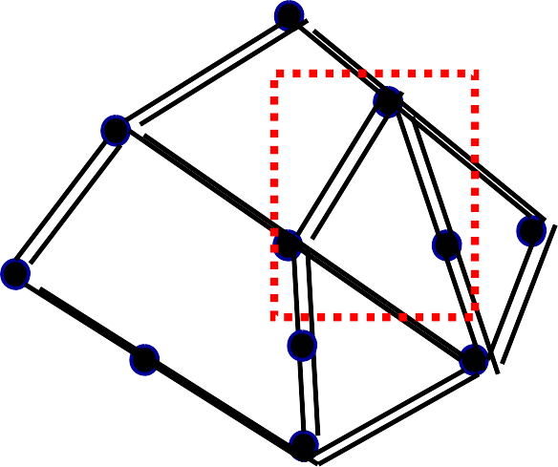
Example
Let A={1,2,3,…,11} be the poset whose Hasse diagram is shown below. Find the LUB and GLB of B={6,7,10}, if they exist.
The upper bounds of B are 10, 11, and
11
LUB(B) is 10 (the first vertex that can be Reached from {6,7,10} by upward paths)
10
9
The lower bounds of B are 1,4, and
7
8
GLB(B) is 4 (the first vertex that can be
Reached from {6,7,10} by downward paths )
5
6
3
2
4
1

Slide 22
Lattices
Lattice as a POSET
A lattice is a poset (L, ≤) in which every subset {a, b} consisting of two elements has a least lower bound and a greatest lower bound.
we denote
LUB({a, b}) by a ⊕ b (the join or sum of a and b)
GLB({a, b}) by a *b (the meet or product of a and b)

Slide 23
Lattices
Example
Let S be a set and let L=P(S). As we have seen, ⊆, containment, is a partial order relation on L. Let A and B belong to the poset (L, ⊆). Then
a ⊕ b =A U B & a * b = A ∩ B
Why?
Assuming C is a lower bound of {a, b}, then A ⊆ C and B ⊆ C thus A U B ⊆ C
Assuming C is a lower bound of {a, b}, then C ⊆ A and C ⊆ B thus C ⊆ A ∩ B

Slide 24
Lattices
Example
consider the poset (Z⁺, ≤), where for a and b in Z⁺, a ≤ b if and only if a | b , then
a ⊕ b = LCM(a, b) a * b = GCD(a, b)
LCM: least common multiple GCD: greatest common divisor

Slide 25
Lattices
Example
Let n be a positive integer and D_{n}
be the set of all
positive divisors of n. Then D_{n} is a lattice under the relation of divisibility. For instance,
D₂₀= {1,2,4,5,10,20}
20
D₃₀= {1,2,3,5,6,10,15,20}
30
4
10
6
10
15
2
5
2
3
5
1
1

Slide 26
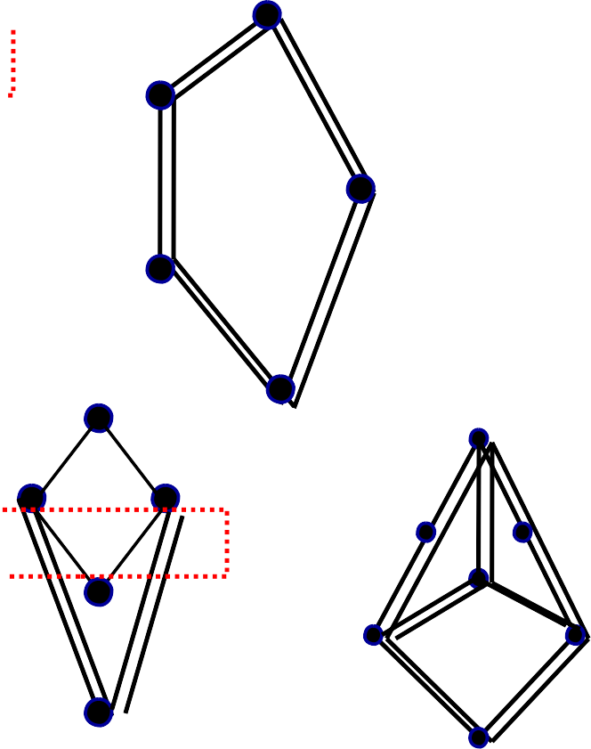
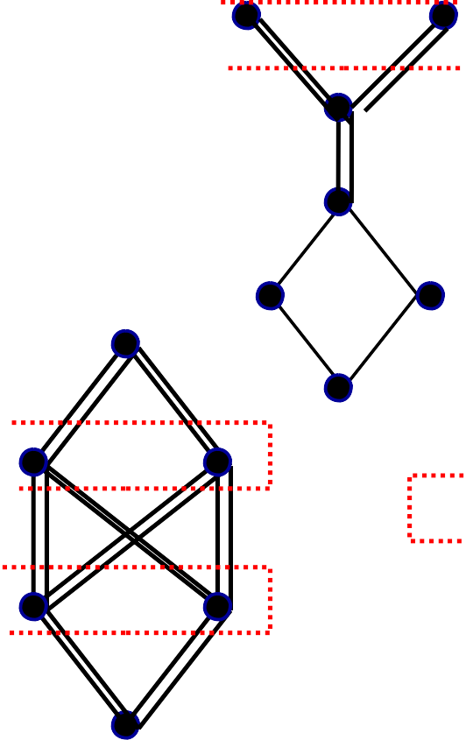
Example 4
Which of the Hasse diagrams represent lattices?
f g e
d
e
d
c
e
c
b
c
d
d
b
c
d
b
b
a
f
b
c
a
a
a
I
a
a
d
e
c
d
b
e
f
b
c
c
a
b
a
a
0

Slide 27
Properties of Lattices
▪ (a ⊕ b) ⊕ c = a ⊕ (b ⊕ c) = a ⊕ b ⊕ c
▪ (a* b)* c = a * (b * c) = a * b * c
▪ LUB({a₁,a₂,…,a_{n}})= a₁ ⊕ a₂ ⊕ … ⊕ a_{n}
▪ GLB({a₁,a₂,…,a_{n}}) =a_{1 *} a_{2 *} … * a_{n}

Slide 28
Lattices
Important Result:
Let L be a lattice. Then for every a and b in L
a ⊕ b =b if and only if a ≤ b
a * b =a if and only if a ≤ b
a * b =a if and only if a ⊕ b =b
Proof:
if a ⊕ b =b, since a≤ a ⊕ b, thus a ≤ b
if a ≤ b, since b ≤ b , thus b is a upper bound of a and b, by definition of least upper bound we have a ⊕ b ≤ b. since a ⊕ b is an upper bound of a and b, b ≤ a ⊕ b, so a ⊕ b =b
Similar to (a); (c) the proof follows from (a) & (b)

Slide 29
Lattices
Important Result:isotonicity
Let L be a lattice. Then, for every a, b and c in L
If b ≤ c, then
a ⊕ b ≤ a ⊕ c
a * b ≤ a * c
a ≤ b and a ≤ c if and only if a ≤ b ⊕ c
a ≤ b and a ≤ c if and only if a ≤ b *c
If a ≤b and c ≤d, then
a ⊕ c ≤ b ⊕ d
a * c ≤ b*d

Slide 30
Dual of a Lattice
Let R be a partial order on a set A, and let R⁻¹ be the inverse relation of R. Then R⁻¹ is also a partial order.
The poset (A, R⁻¹) is galled the dual of the poset (A, R). whenever (A, ≤) is a poset, we use “≥” for the partial order ≤⁻¹
Dual of a lattice: Let (L, ≤) be a lattice, then the (L, ≥) is called dual lattice of (L, ≤).
Note: Dual of dual lattice is original lattice.
Note: In (L, ≤), if a ⊕ b = c; a ∗ b = d, then in dual lattice (L, ≥), a ⊕ b = d; a ∗ b = c
Principle of duality: If P is a valid statement in a lattice, then the statement obtained by interchanging meet and join everywhere and replacing ≤ by ≥ is also a valid statement.
▪
▪
▪
▪

Slide 31
Example
Fig. a shows the Hasse diagram of a poset (A, ≤), where
A={a, b, c, d, e, f}
Fig. b shows the Hasse diagram of the dual poset (A, ≥)
f
a
b
c
d
e
d
e
a
b
c
f

Slide 32
Dual poset
Some properties of dual of poset:
The upper bounds in (A, ≤ ) correspond to lower bounds in (A, ≥) (for the same set of elements)
The lower bounds in (A, ≤ ) correspond to upper bounds in (A, ≥) (for the same set of elements)
Similar statements hold for greatest lower bounds and least upper bounds.
Note: An element a of (A, ≤ ) is a greatest (or least) element if and only if it is a least (or greatest) element of (A, ≥ )

Slide 33
Lattices as algebraic structures
An algebraic structure (L, ∨, ∧), consisting of a set L and two binary operations ∨, and ∧, on L is a lattice if the following axiomatic identities hold for all elements a, b, c of L.
Commutative laws
a ⊕ b = b ⊕ a, a * b = b * a.
Associative laws
a ⊕ (b ∨ c) = (a ⊕ b) ⊕ c, a * (b * c) = (a * b) *c.
Absorption laws a ⊕ (a * b) = a, a * (a ⊕ b) = a.
Idempotent laws a ⊕ a = a , a * a = a.

Slide 34
a R b a,b belongs to L
a * b =a
a ⊕ b = b

Slide 35
Sub-Lattices
Consider a non-empty subset L₁ of a lattice < L, *, ⊕> . Then L₁ is called a sub-lattice of L if L₁ itself is a lattice i.e., the operation of L i.e., a ⊕ b ∈ L₁ and a * b ∈ L₁ whenever a ∈ L₁ and b ∈ L₁. <L1, *, ⊕>
Example: Consider the lattice of all +ve integers I₊ under the operation of divisibility. The lattice D_{n} of all divisors of n > 1 is a sub-lattice of I₊.
Determine all the sub-lattices of D₃₀ that contain at least four elements, D₃₀={1,2,3,5,6,10,15,30}.
Solution: The sub-lattices of D₃₀ that contain at least four elements are as follows:
1. {1, 2, 6, 30} 2. {1, 2, 3, 30} 3. {1, 5, 15, 30} 4. {1, 3, 6, 30} 5. {1, 5, 10, 30} 6. {1, 3, 15, 30} 7. {2, 6, 10, 30}

Slide 36
Direct product of lattices
Let (L₁ ⊕₁ *₁)and (L₂ ⊕₂ *₂) be two lattices. Then (L, *, ⊕) is the direct product of lattices, where L = L₁ x L₂ in which the binary operation ∨(join) and *(meet) on L are such that for any (a₁,b₁)and (a₂,b₂) in L.
(a₁,b₁) ⊕( a₂,b₂ )=(a₁ ⊕1 a₂,b₁ ⊕₂ b₂) and (a₁,b₁) * ( a₂,b₂ )=(a₁ *₁ a₂,b₁ *₂ b₂).

Slide 37
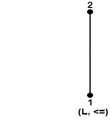
Consider a lattice (L, ≤) as shown in fig. where L = {1, 2}. Determine the lattices (L², ≤), where L²=L x L.

Slide 38
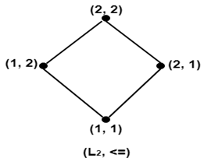
The lattice (L², ≤) is shown in fig:

Slide 39
Bounded Lattices
Bounded
A lattice L is said to be bounded if it has a greatest element 1 and a least element 0
For instance:
Example: The lattice P(S) of all subsets of a set S, with the relation containment is bounded. The greatest element is S and the least element is empty set.
Example : The lattice Z⁺ under the partial order of divisibility is not bounded, since it has a least element 1, but no greatest element.

Slide 40
Bounded Lattices
If L is a bounded lattice, then for all a in A 0 ≤ a ≤ 1
a ∨ 0 = a, a ∧ 0 = 0 ,
a ∨ 1 = 1 a ∧ 1 = a
Note: 1(0) and a are comparable, for all a in A.

Slide 41
Distributive Lattices
Distributive
A lattice (L, ≤) is called distributive if for any elements a, b and c in L we have the following distributive properties:
1. a ∧ (b ∨ c) = (a ∧ b) ∨ (a ∧ c)
2. a ∨ (b ∧ c) = (a ∨ b) ∧ (a ∨ c)
If L is not distributive, we say that L is nondistributive.
Note: the distributive property holds when
any two of the elements a, b and c are equal or
when any one of the elements is 0 or I.

Slide 42
Distributive Lattices
Example
For a set S, the lattice P(S) is distributive, since join and meet
{a,b,c}
{b,c}
{a,b}
{a,c}
{c}
each satisfy the distributive property.
{b}
{a}
ф
Example
The lattice whose Hasse diagram shown in adjacent diagram
is distributive.
I
b
d
a
c
0

Slide 43
Distributive Lattices
Example
Show that the lattices as follows are non-distributive.
Pentagonal Lattice
I
I
a
c
a
b
c
b
0
0
a∧( b ∨ c) = a ∧ I = a
(a∧ b)∨(a ∧ c) = b ∨ 0 = b
a∧( b ∨ c) = a ∧ I = a
(a∧ b)∨(a ∧ c) = 0 ∨ 0 = 0

Slide 44
Modular Lattices
A lattice (L, ≤) is called Modular if for any elements a, b and c in L if b ≤ a then
b ∨ (a ∧ c) = a ∧ (b ∨ c)
Example
For a set S, the lattice P(S) is modular, (if B ⊆ A)
B ∪ (A ∩ C) = A ∩ (B ∪ C)
{a,b,c}
{b,c}
{a,b}
{a,c}
{c}
{b}
{a}
ф

Slide 45
▪
Example
Every chain is a modular lattice
▪
Example: Given Hasse diagram of a lattice which is modular
I
0 ≤ a i.e. taking b=0;
a
b
c
b ∨ (a ∧ c) = 0 ∨ 0 = 0 a ∧ (b ∨ c) = a ∧ c = 0
0

Slide 46
Complemented Lattice
Complement of an element:
Let L be bounded lattice with greatest element 1 and least element 0, and let a in L. An element b in L is called a complement of a if
a ∨ b = 1 and a ∧ b =0 Note: 0’ = 1 and 1’ = 0
Complemented Lattice:
A lattice L is said to be complemented if it is bounded and every element in it has a complement.

Slide 47
Complemented Lattice
Example
The lattice L=P(S) is such that every element has a complement, since if A in L, then its set complement A
has the properties A ∨ A = S and A ∧ A=ф. That is, the set complement is also the complement in L.
Example : complemented lattices where complement of element
▪
is not unique
a
I I
c
a
b
c
b
0
0

Slide 48
Complemented Lattice
Example: D₂₀ is not complemented lattice
20
Element | Its Complement
1 | 20
2 | 10
4 | 5
5 | 4
10 | 2
20 | 1
4
10
2
5
1
^{D}20
2 ∧ 10 ≠ 0 (2 ∧ 10 = 2)

Slide 49
Complemented Lattice
D₃₀ is complemented lattice
30
Element
Its Complement
1
30
6
10
15
2
15
3 | 10
5 | 6
6 | 5
10 | 3
15 | 2
30 | 1
2
3
5
1
^{D}30

Slide 50
Lattices
Theorem: Let L be a bounded distributive lattice. If a complement exists, it is unique.
Proof: Let a’ and a’’ be complements of the element a in L, then a ∨ a’ = 1, a ∨ a’’= 1 ; a ∧ a’ = 0, a ∧ a’’ =0
using the distributive laws, we obtain
a’= a’ ∨ 0 = a’ ∨ (a ∧ a’’ ) = (a’ ∨ a) ∧ (a’ ∨ a’’)
= 1 ∧ (a’ ∨ a’’) = a’ ∨ a’’
Also
a’’= a’’ ∨ 0 = a’’ ∨(a ∧ a’ ) = (a’’ ∨ a) ∧ (a’’ ∨ a’)
= 1 ∧ (a’ ∨ a’’) = a’ ∨ a’’
Hence a’=a’’

Slide 51
Boolean Algebra
▪Boolean algebra provides the operations and the rules for working with the set {0, 1}.
▪These are the rules that underlie electronic circuits, and the methods we will discuss are fundamental to VLSI design.
▪We are going to focus on three operations:
Boolean complementation,
Boolean sum and
Boolean product

Slide 52
Boolean Operations
▪The complement is denoted by a bar. It is defined by
0 = 1 and 1 = 0.
▪The Boolean sum, denoted by + or by OR, has the following values:
1 + 1 = 1, 1 + 0 = 1, 0 + 1 = 1, 0 + 0 = 0
▪The Boolean product, denoted by ⋅ or by AND, has the following values:
1 ⋅ 1 = 1, 1 ⋅ 0 = 0, 0 ⋅ 1 = 0, 0 ⋅ 0 = 0

Slide 53
Examples:
1) Find the values of 1.0 + (0 + 1) + 0.0 2) Show that (1.1) + [(0 . 1) + 0] = 1
3) Find the values of (1 . 0) + (1 . 0)
Note:
The complement, Boolean sum and Boolean product correspond to the logic operators ∼ , ∨ and ∧ respectively, where 0 corresponds to F (False) and 1 corresponds to T (True)
Equalities in Boolean algebra can be considered as equivalences of compound propositions.
▪

Slide 54
Translate the following into logical equivalence:
1) 1.0 + (0 + 1) = 0
2) (1.1) + [(0 . 1) + 0] = 1
Translate the logical equivalences into Boolean algebra:
1) (T ∧ T) ∨ [∼(F ∧ T) ∨ F] ≡ T
2) (T ∨ F) ∧ (∼F) ≡ F

Slide 55
Boolean Expressions & Boolean Functions:
▪
Let B={0,1}, then B^{n} = {(x₁, x₂, …, x_{n}) / x_{i} ∈ B for I = 1 to n} is the set of all possible n-tuples of 0’s and 1’s.
Boolean variable: The variable x is called a Boolean variable if it assumes values only from B. i.e. if its only possible values are 0 and 1.
Boolean function of degree n: A function F: B^{n} → B,
i.e. F(x₁, x₂, …, x_{n}) = x, is called a Boolean function of degree n.
▪
▪
E.g.
1) F(x, y) = x.y from the set of ordered pairs of Boolean variables to the set
{0, 1} is a Boolean function of degree 2 with given values in table:
x y y F
1 1 0 0
1 0 1 1
0 1 0 0
0 0 1 0

Slide 56
Examples of Boolean Functions:
2) Boolean Function:
F = x + y z
* Truth Table
All possible combinations of input variables
x | y | z | F
0 | 0 | 0 | 0
0 | 0 | 1 | 1
0 | 1 | 0 | 0
0 | 1 | 1 | 0
1 | 0 | 0 | 1
1 | 0 | 1 | 1
1 | 1 | 0 | 1
1 | 1 | 1 | 1

Slide 57
Finite Boolean Algebra
Example:
S={a, b, c} and T={2,3,5}. consider the Hasse diagrams of the two lattices (P(S), ⊆) and (P(T), ⊆).
{a,b,c}
{2,3,5}
{a,b}
{b,c}
{2,3}
{3,5}
{a,c}
{2,5}
{b}
{3}
{a}
{c}
{2}
{5}
ф ф
Note : the lattice depends only on the number of elements in set, not on the elements.

Slide 58
6.4 Finite Boolean Algebras
▪ (P(S), ⊆)
Each x and y in B_{n} correspond to subsets A and B of S. Then x ≤ y, x ∧ y, x ∨ y and x’ correspond to A ⊆ B, A ∩ B, A U B and A. Therefore,
(P(S), ⊆) is isomorphic with Bn, where n=|S|
Example
Consider the lattice D₆ consisting of all positive integer
divisors of 6 under the partial order of divisibility.
6
(1,1)
D₆ is isomorphic
(1,0)
(0,1)
2
3
1
(0,0)

Slide 59
6.4 Finite Boolean Algebras
Example
consider the lattices D₂₀ and D₃₀ of all positive integer divisors of 20 and 30, respectively.
20
30
D₂₀ is not a Boolean algebra (why? 6 is not 2^{n} )
4
10
6
10
15
2
5
2 3
D₃₀ is a Boolean algebra, D₃₀ → B₃
5
1
1

Slide 60
6.4 Finite Boolean Algebras
Example: Show the lattice whose Hasse diagram shown below is not a Boolean algebra.
I
a
e
a and e are both gomplements of g
f
Theorem (e.g. properties 1~14) is usually used to show that a lattice L is not a Boolean algebra.
d
b
g
0

